Slide 1

RWE in Regulatory Decision Making
Yasser Albogami, MPH, Ph.D.
EDRA 543
Lecture, 2023

Slide 2



Important terminology related to RWE
 | Real world data | Real world insights | Real world evidence
Definition | Data relating to patient health status and/or delivery of health care routinely collected from a variety of sources | Answers to internal research questions derived from analyzing real world data | Clinical evidence about the usage and potential benefits or risks of a medical product derived from analysis of RWD
Examples | Medical claims and billing Electronic health records Patient/product registries Patient surveys | Hypothesis generation Feasibility Patient journey Unmet needs | Evidence supporting: Effectiveness Safety Outcomes
Analogy

Slide 3
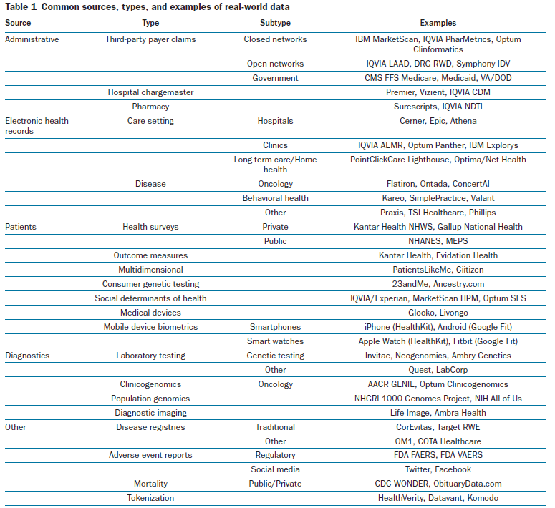




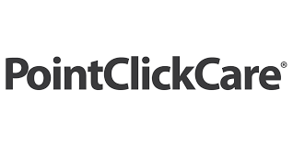













Slide 4



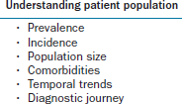
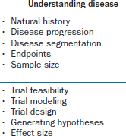
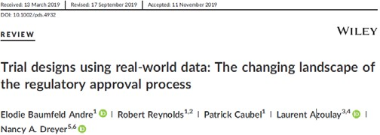
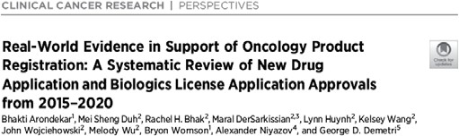
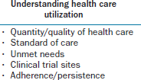
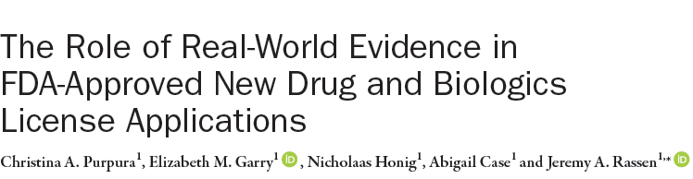
RWE can be a powerful tool at every step of the product development process
Early
Mid
Late
1
R&D
3
FIH
5 Phase 3
7 Post-approval
2
Pre-clinical
4
Phase 2
6 Submission
8 LCM

Slide 5
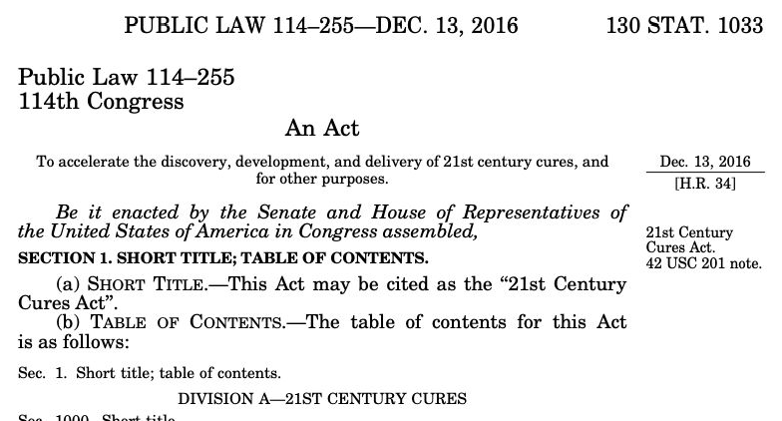

From Safety to Effectiveness
Much of FDA regulatory use of RWE to date has been in the context of postmarket surveillance.
21st Century Cures Act (2016) required FDA to develop a program for RWE to support new indications for
already-approved products and fulfill post-market requirements.

Slide 6
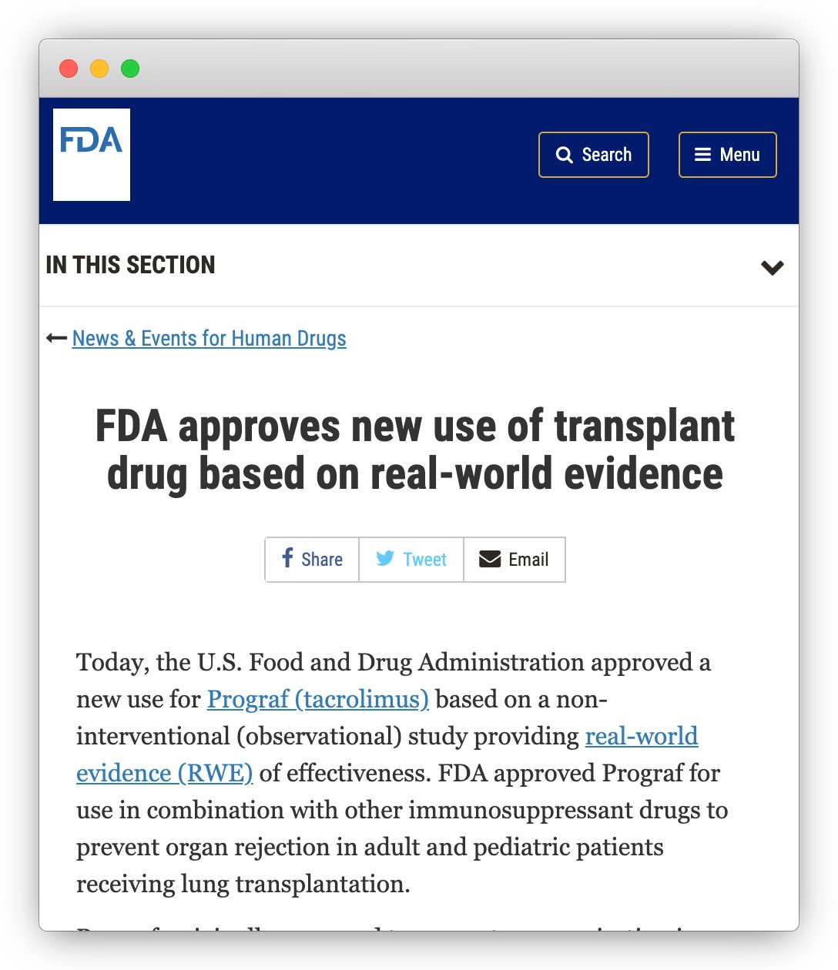
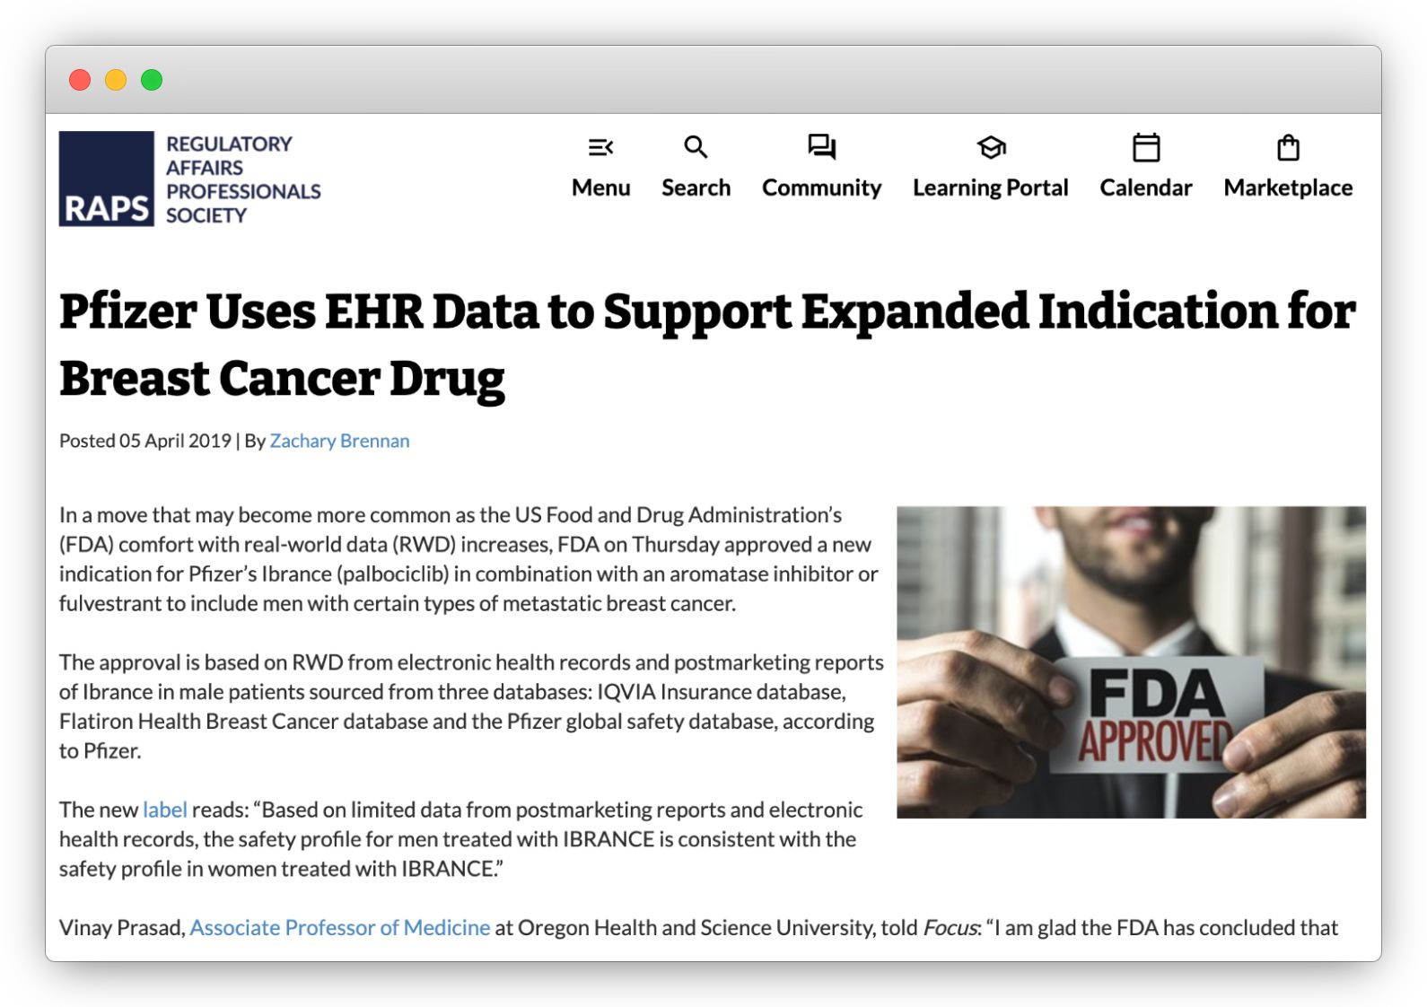
Recent approvals

Slide 7
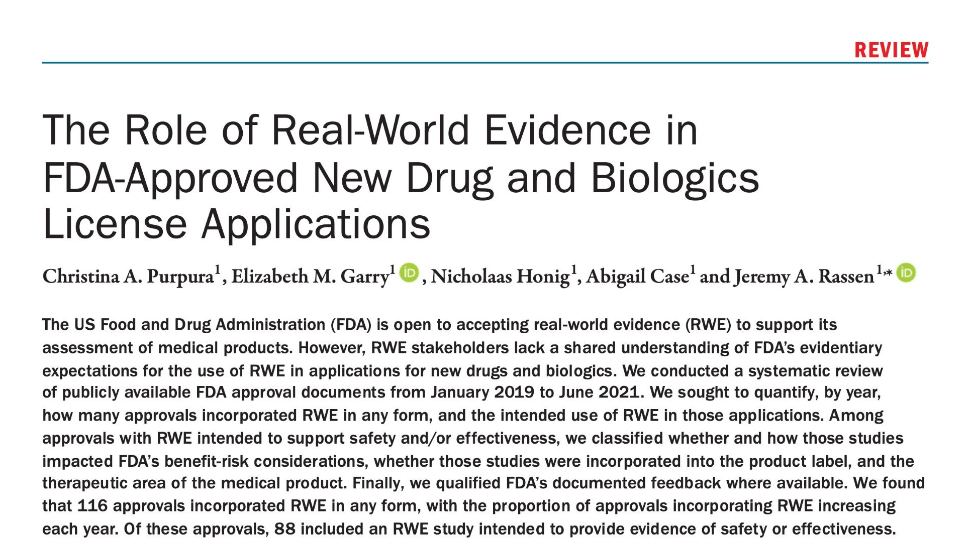
How often?

Slide 8
How often?
FDA-approved NDAs and BLAs* 378
Excluded
242
Type 2-8 and 10 NDAs 182 Non-NME 505(b)(2) applications 3 Medical gas approvals 8
Unidentified NDAs 1
Assays 9
Solutions 4
Blood products 15
351(k) biosimilars 15
Approval documents not yet 5 available
Approvals considered Jan 2019 - June 2021
Drugs and biological products of interest
136
Excluded new formulations or combinations; assays, solutions and blood products; and approvals for which full documentation was not yet available.

Slide 9
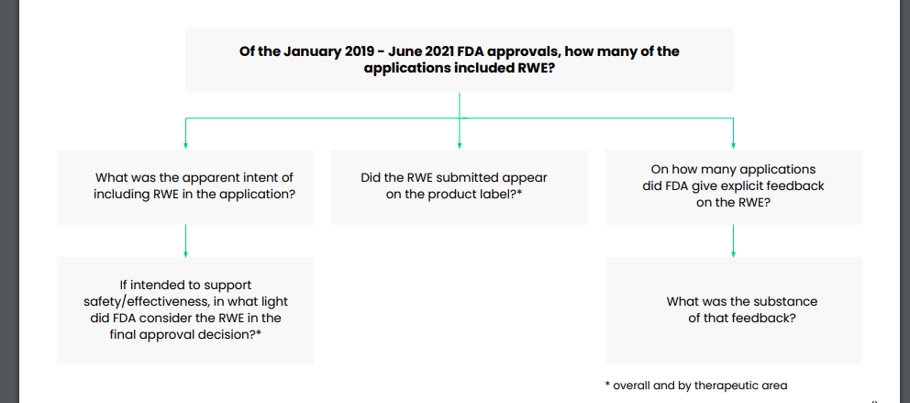
Hypothetical Example

Slide 10
Frequency of inclusion of RWE
Observed use of RWE in included NDAs/BLAs, January 2019 to June 2021.
2019 Included NDAs and BLAs n=51 approvals | 2020 n=59 approvals | 2021 (Jan 1-June 30) n=26 approvals | Total n=136 approval
Incorporated RWE for any purpose 38 (75%) | 53 (90%) | 25 (96%) | 116 (85%)
s

Slide 11
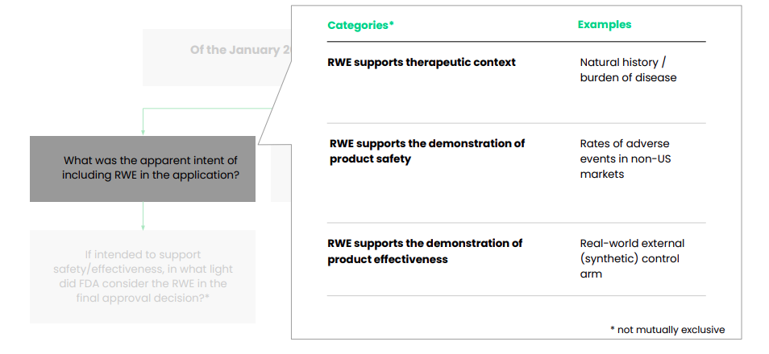
Measuring intended purpose of a study

Slide 12
Observed intent of RWE
Observed apparent intended use of RWE in included NDAs/BLAs, January 2019 to June 2021. Categories are not mutually exclusive.
Included NDAs and BLAs
2019 2020 2021 (Jan 1-June 30)
Total
n=51 approvals | n=59 approvals | n=26 approvals | n=136 approvals
Incorporated RWE for any purpose 38 (75%) | 53 (90%) | 25 (96%) | 116 (85%)
Used RWE to provide therapeutic _{25 (49%)} | 36 (61%) | 22 (85%) | 83 (61%)
Used RWE to support safety and/or _{27 (53%)} | 46 (78%) | 15 (58%) | 88 (65%)
… Safety only 17 (33%) | 21 (36%) | 5 (19%) | 43 (32%)
… Effectiveness only 7 (14%) | 6 (10%) | 2 (8%) | 15 (11%)
… Safety and effectiveness 3 (6%) | 19 (32%) | 8 (31%) | 30 (22%)
context
effectiveness

Slide 13
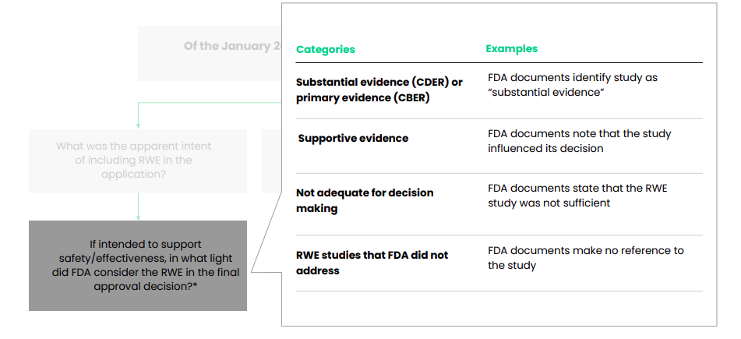
Measuring RWE’s impact

Slide 14
Decision-making impact of RWE
Observed FDA use of applicant-submitted RWE in considered approvals, January 2019 to June 2021
FDA’s use of RWE
2019 2020
2021 (Jan 1-June 30)
Total
 | n=27 approvals | n=46 approvals | n=15 approvals | n=88 approvals
Substantial or primary evidence | 3 (11%) | 4 (9%) | 1 (7%) | 8 (9%)
Supportive evidence | 16 (59%) | 30 (65%) | 11 (73%) | 57 (65%)
Not adequate for decision making | 6 (22%) | 4 (9%) | 3 (20%) | 13 (15%)
RWE studies that FDA did not address | 2 (7%) | 8 (17%) | 0 (0%) | 10 (11%)

Slide 15
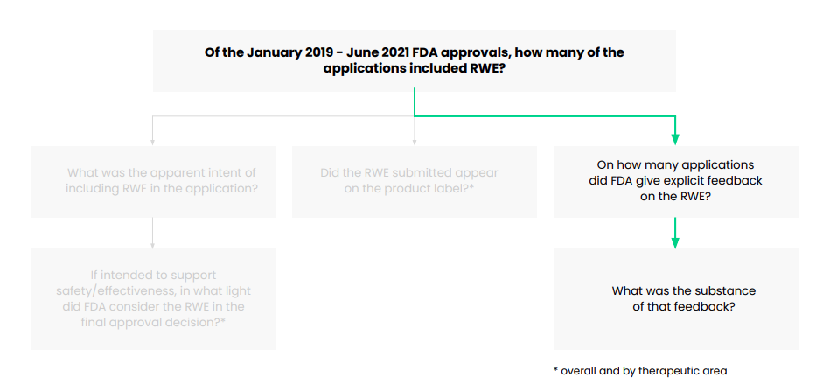
FDA’s feedback

Slide 16
FDA’s feedback
Observed FDA feedback, by benefit/risk evidence classification, January 2019 to June 2021.
All
of n=116 approvals
Received any FDA feedback
37 (32%)

Slide 17
Qualifying FDA’s RWE study concerns
Observed FDA feedback, by benefit/risk evidence classification, January 2019 to June 2021. Categories are not mutually exclusive.
All
of n=116 approvals
Received any FDA feedback
37 (32%)
… Methodological issues
23
… Sample size concern
8
… Omission of patient-level data
3
… Other limitations
13

Slide 18
FDA’s feedback
Methodological issues
“Due to major methodological issues (including immortal time bias, selection bias, misclassification, confounding, and missing data), FDA did not consider RWD adequate to support regulatory decision making.”
>>
Omission of patient-level data
“While FDA considers [real world] data from [the submitted studies] to be supportive, [the sponsor] did not submit this data, and thus FDA cannot independently verify these results.”
>>
Methodological issues, Other limitations
“Several important methodological issues impact interpretability of these findings, including… differential selection of comparison groups, specifically, that trial patients were enrolled from academic medical centers primarily from Europe, while [RWD] controls were enrolled from community oncology centers in the US.”
>>

Slide 19
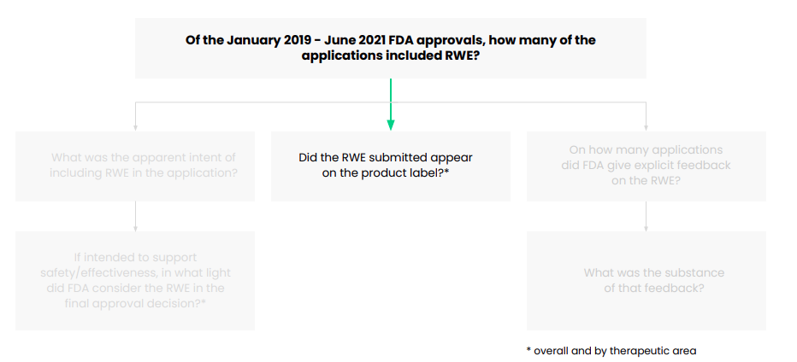
Impact on product labeling

Slide 20
Impact on product labeling
Observed inclusion of RWE in product labels, January 2019 to June 2021.
Approvals including RWE in product label
of n=116 approvals
All
38 (33%)

Slide 21
Impact on product labeling
Observed inclusion of RWE in product labels, by benefit/risk evidence classification, January 2019 to June 2021.
 | Approvals including RWE in product label of n=116 approvals
All | 38 (33%)
… Substantial/ primary evidence | 7 (18%)
… Supportive evidence | 30 (79%)
… Not adequate for decision making | 0 (0%)
… Unaddressed by FDA | 1 (3%)

Slide 22
RWE in FDA approvals by therapeutic area
Total approvals per therapeutic area
RWE included in submission of n=116 approvals
RWE intended to support safety and/or effectiveness
Therapeutic area
 | of n=136 approvals |  | in n=88 approvals
Oncology | 43 | 41 (95%) | 30 (70%)
Neuroscience | 25 | 20 (80%) | 13 (52%)
Infectious disease | 17 | 17 (100%) | 16 (94%)
Endocrinology & metabolism | 14 | 11 (79%) | 8 (57%)
Radiology | 6 | 6 (100%) | 6 (100%)
Hematology | 4 | 4 (100%) | 2 (50%)
Dermatology | 4 | 3 (75%) | 2 (50%)
Cardiovascular | 2 | 2 (100%) | 2 (100%)
Gastroenterology | 3 | 2 (67%) | 2 (67%)

Slide 23
Conclusion
Use of WE is frequent and is included in the vast majority of US approvals from 2019-2021, with particularly frequent use in oncology, neuroscience and infectious disease
Successful use of WE in regulatory approvals required:
• fit-for-purpose data
• good study design, appropriate data collection, and thoughtful data analysis
• proactive communication with FDA
FDA has issued three draft guidances since September 2021 (assessment of HR and claims real-world data, assessment of registry data, data standards), with more to come.

